Slide 1
ESRGAN and RCAN

Slide 2
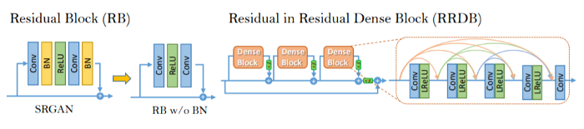
ESRGAN: Key Notes
“To further enhance the visual quality, we thoroughly study three key components of SRGAN — network architecture, adversarial loss and perceptual loss, and improve each of them to derive an Enhanced SRGAN (ESRGAN)” - as quoted in paper
Network Architecture
Replaced all original block units with RRDB
Removed BN layers to avoid artifacts

Slide 3
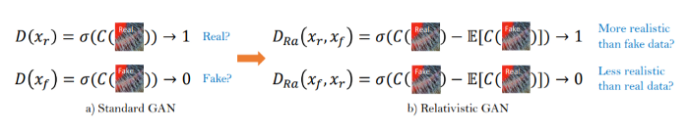
2. Adversarial Loss
Used relativistic discriminator instead of standard discriminator
3. Perceptual Loss
The perceptual loss is improved in the ESRGAN by using the features before activation which could lead to brightness consistency and texture recovery.
Reason: The activated features are very sparse which provides weak supervision and thus leads to inferior performance.

Slide 4
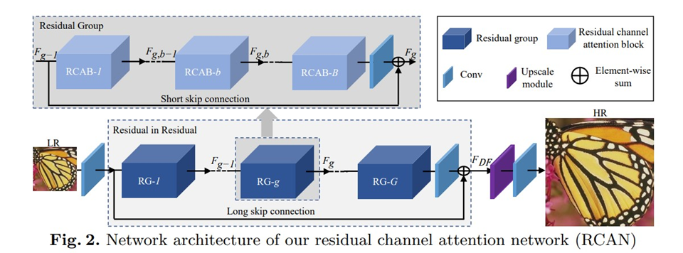
RCAN: Key Notes & architecture design
Built on top of EDSR.
L1 loss function
No Batch Norm
Stacked Residual blocks
10 Residual Groups (RG), each containing 20 RCAB units each.
16 Million parameters and >400 layers(deepest network) indicates deeper networks may be easier to achieve better performance than wider networks.

Slide 5
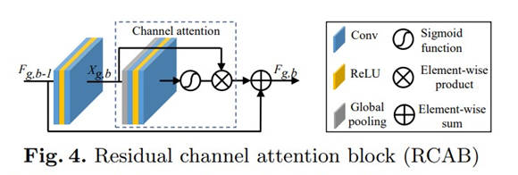
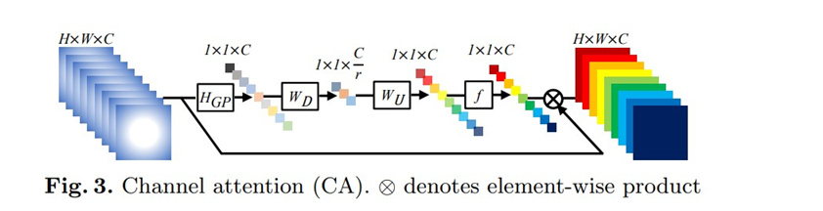
To capture the more informative features, it exploits the interdependencies among feature channels, resulting in a channel attention (CA) mechanism.

Slide 6
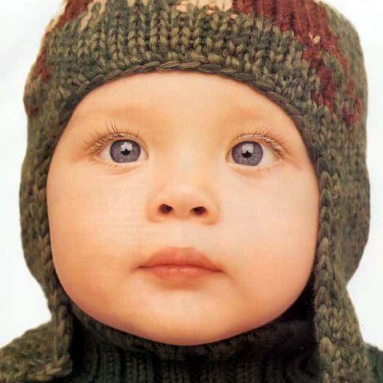
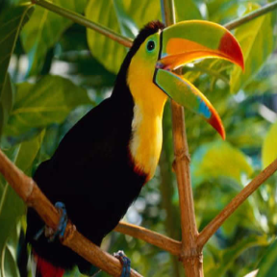
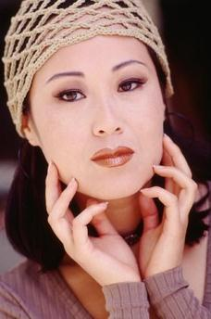
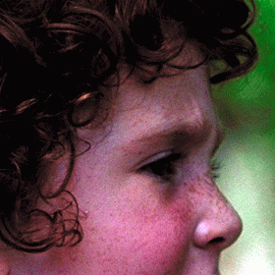
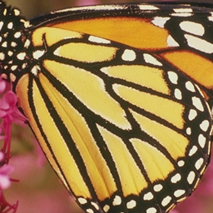
Set5 Dataset
baby.png
bird.png
woman.png
butterfly.png
head.png

Slide 7
Quantitative Results (4x upscaling)
Model Name | PSNR (Ours) | PSNR (Author) | SSIM (Ours) | SSIM (Author)
EDSR | 32.095 | 32.46 | 0.892 | 0.8968
RCAN+ | 32.738152 | 32.73 | 0.900286 | 0.9013
SRGAN | 29.373820 | 29.40 | 0.841682 | 0.8472
ESRGAN | 32.730021 | 32.73 | 0.901131 | 0.9011

Slide 8
Qualitative Results

Slide 9



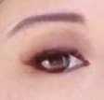

Low Resolution
Input Image
EDSR
RCAN
SRGAN
High Resolution
Ground Truth
ESRGAN

Slide 10



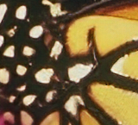
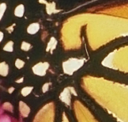
Low Resolution
Input Image
EDSR
RCAN
SRGAN
High Resolution
Ground Truth
ESRGAN

Slide 11

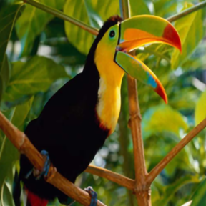

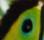

Low Resolution
Input Image
EDSR
RCAN
SRGAN
High Resolution
Ground Truth
ESRGAN

